Slide 1
Agile Fundamentals and Effective Collaboration tools Nano-project
Victoria Madamidola

Slide 2
Task
To manage the process of developing a food delivery service for FoodFirst Inc., a company that offers menu food items for the working class

Slide 3
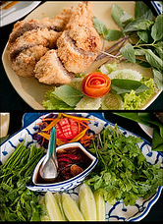
Introduction
FoodFirst has stores in eight location across the city and they would like to start up a food delivery service for their customers. The company has commissioned the Business Analyst to manage the process of developing the service
The task is highlighted in this presentation as follows
A project requirement plan
Story mapping and epics and user stories
Story points and values for each user story
Acceptance criteria and subtasks.
This Photo by Unknown Author is licensed under CC BY-NC-ND

Slide 4
Introduction (contd.)
The task began with a sprint planning meeting by the team including FoodFirst contact person
The Scrum Master coordinated the team meetings
The project planning document is produced from the planning meeting which comprises of the project scope, problem statement, aims and objectives as shown in the next slide

Slide 5
Project Scope and Problem Statement
Project Scope: FoodFirst Inc. wants to set up a website for a food delivery service | Problem Statement: The working class in the city has the challenge of accessing the food stores across the city due to their busy schedule and traffic congestion within the city
Aim: To create a website that allows working class customers order menu | Objectives: Increase customer base Deliver customer satisfaction Provide an easy platform for customers to order food Develop a user-friendly website

Slide 6
FoodFirst Inc Product Backlog and Story Mapping
The user story describing the functionality that the user of the food service application needs were developed
The acceptance criteria for each user story were also developed as stated in the file attached
The product backlog; the list of to do was also prepared as outlined in the attached file on this slide

Slide 7
Project Requirement Plan
Items
Restaurant type
Asian
British
Chinese
African
Caribbean
Location
2 miles
5 miles
10 miles
Dietary requirements
Vegetarian
Vegan
Gluten free
Delivery
Order reference number
Dispatch
0.5 to 2 hours
Payment
Payment type
Discount/ voucher
Save card details

Slide 8
Project Requirement Plan (contd.)
FAQ/ Feedback
Description of how to place order
Help
Live chat
Contact us
Tracking
Users
Email address/ phone contact (for special offers and alerts)
Create an account using email or phone number
Menu search by restaurant type/ Location/ Dietary requirements/ Price
Filter by price/ food specification/ similar food types
Select
Add selections to cart
Remove selections from cart
Order multiple menus of the same or different food specifications
Checkout selected menus
Edit checkout selections and add new menus
Review and rate
Add label

Slide 9
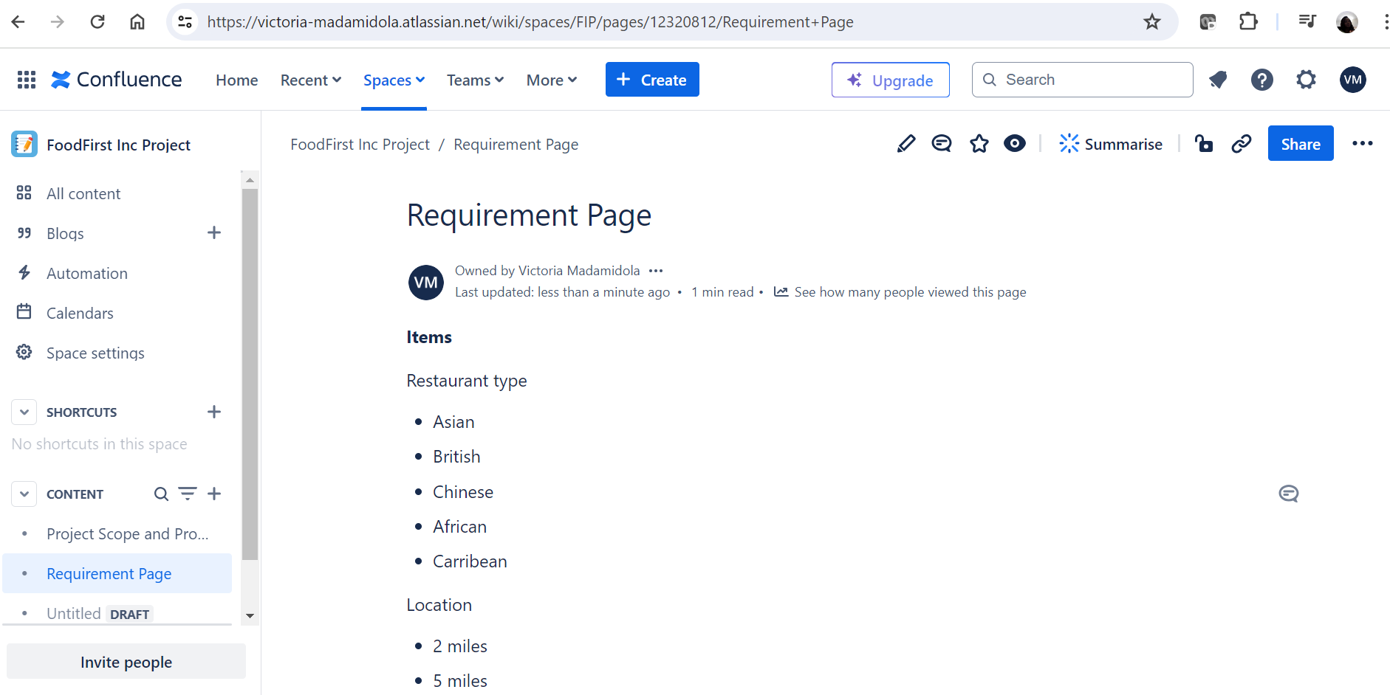
Product Requirement page

Slide 10
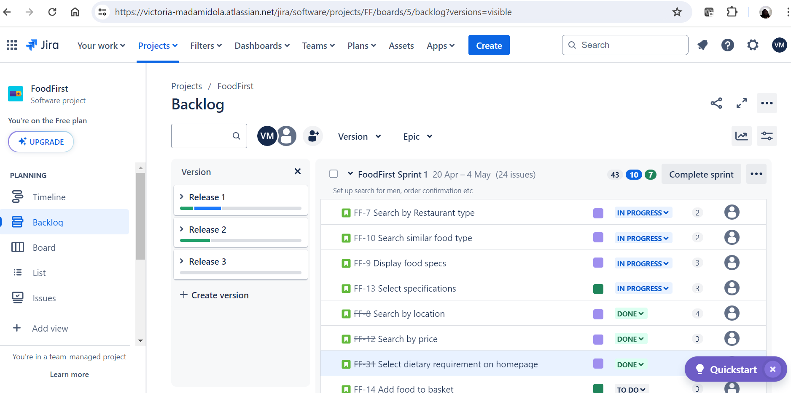
Jira Storyboard

Slide 11
EXPLANATIONS
The user stories were separated into three versions and identified as release 1 to 3 as shown in the previous slide
The estimated time taken for each product backlog was stated and they were all moved to the sprint board
The sprint board helped the team manage the sprint activities so that the product backlogs can be moved and monitored as they get done and everyone is able to see the progress

Slide 12
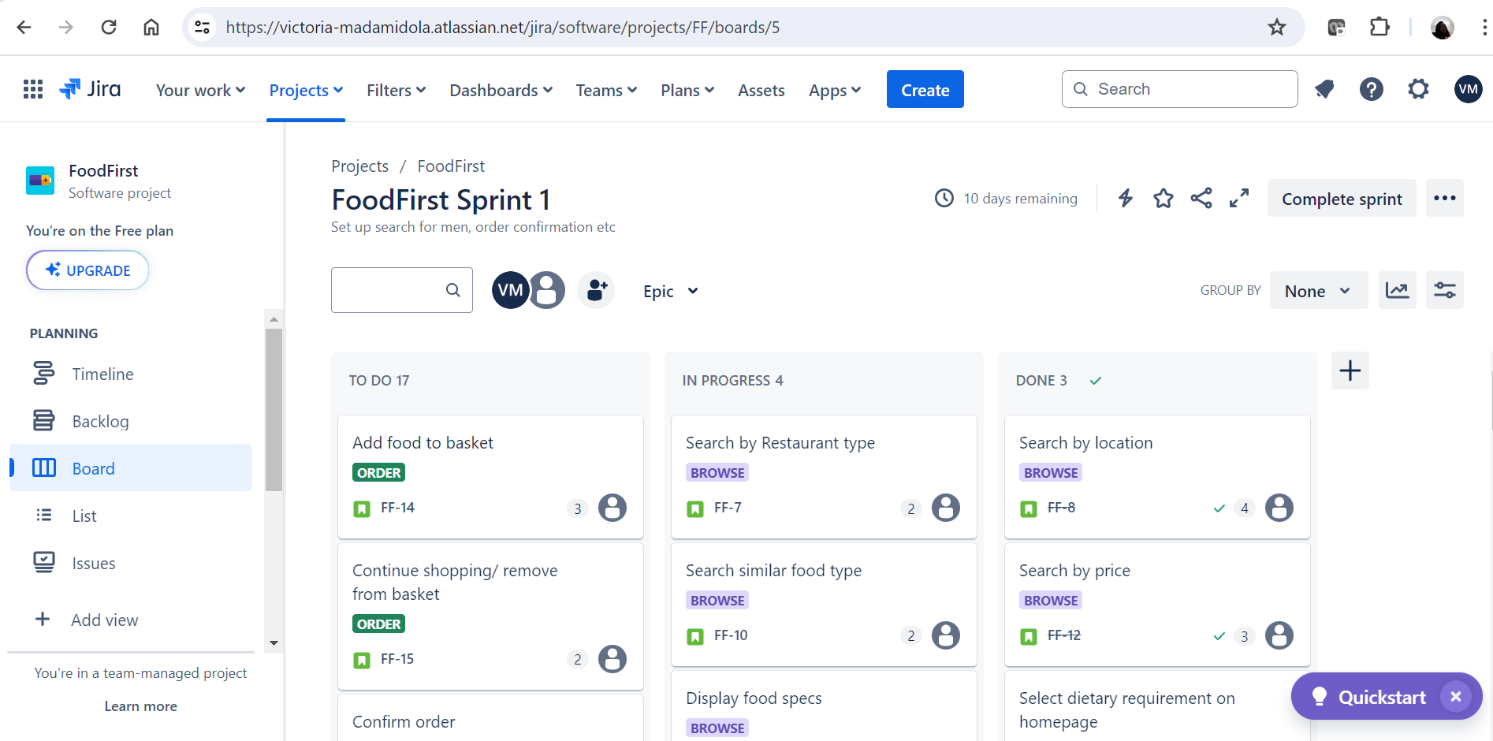
The Sprint Board

Slide 13

Conclusion
Upon completion of all the activities, the button that reads complete sprint is selected. The retrospective template gets generated which the team can use to list the things they need to start, stop or keep doing for the next sprint.
The retrospective is like a review meeting where the team members discuss how the sprint went.
This presentation shows the development of the food delivery service process for FoodFirst Inc., a company that offers menu food items for the working class using Agile project methodology

Slide 14
Thank you

